Slide 1
More Applications of
The Pumping Lemma

Slide 2


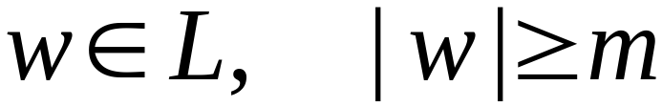

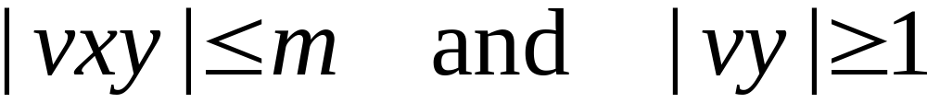
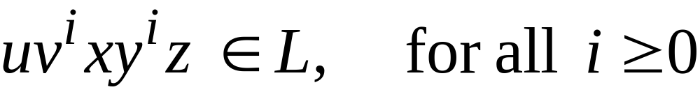
The Pumping Lemma:
For infinite context-free language
there exists an integer such that
for any string
we can write
with lengths
and it must be:

Slide 3
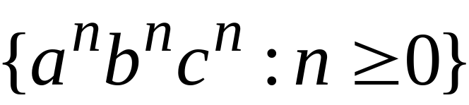
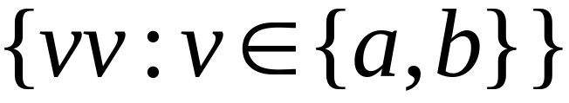

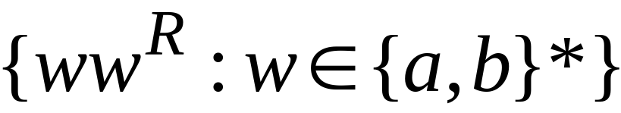
Non-context free languages
Context-free languages

Slide 4
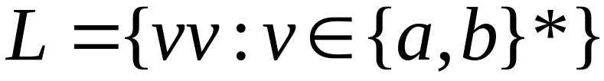
Theorem:
The language
is not context free
Proof:
Use the Pumping Lemma
for context-free languages

Slide 5
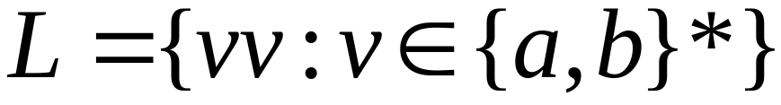
Assume for contradiction that
is context-free
Since is context-free and infinite
we can apply the pumping lemma

Slide 6
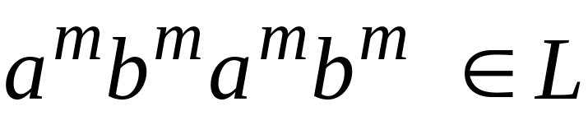
Pumping Lemma gives a magic number
such that:
Pick any string of with length at least
we pick:

Slide 7
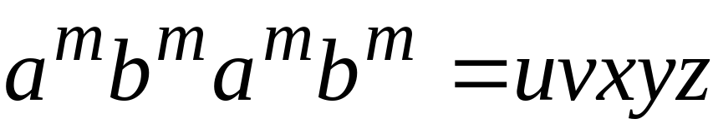
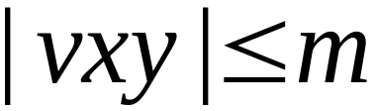
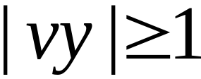
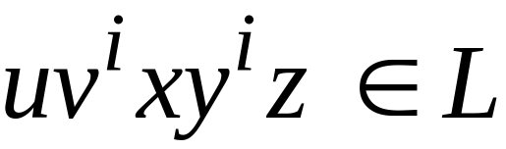

We can write:
with lengths and
Pumping Lemma says:
for all

Slide 8
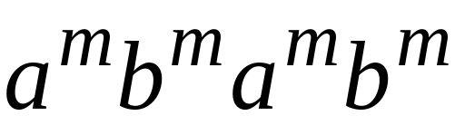

We examine all the possible locations
of string in

Slide 9
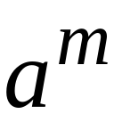
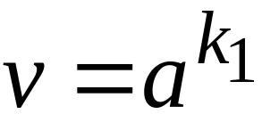
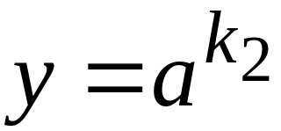
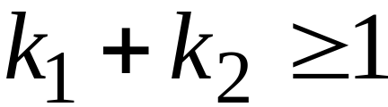





Case 1:
is within the first

Slide 10
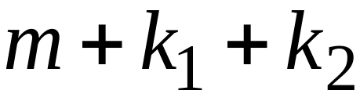
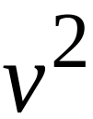
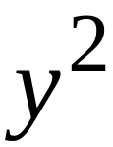
Case 1:
is within the first

Slide 11
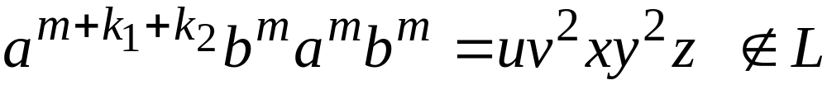
Case 1:
is within the first

Slide 12
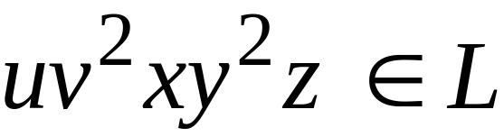
Case 1:
is within the first
However, from Pumping Lemma:
Contradiction!!!

Slide 13
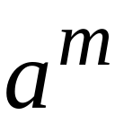
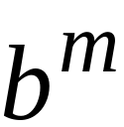
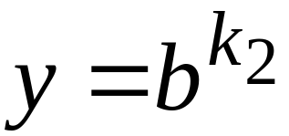
Case 2:
is in the first
is in the first

Slide 14
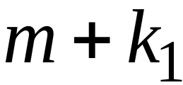
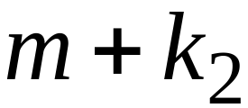
Case 2:
is in the first
is in the first

Slide 15
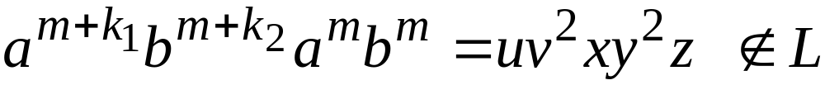
Case 2:
is in the first
is in the first

Slide 16
Case 2:
is in the first
is in the first
However, from Pumping Lemma:
Contradiction!!!

Slide 17
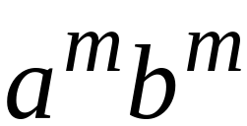
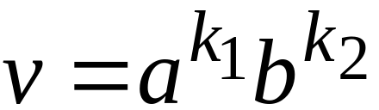
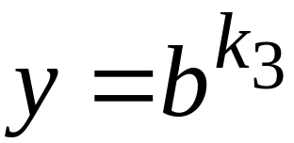
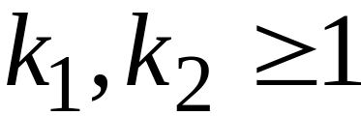
Case 3:
overlaps the first
is in the first

Slide 18


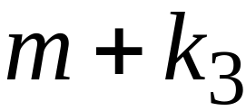
Case 3:
overlaps the first
is in the first

Slide 19
Case 3:
overlaps the first
is in the first

Slide 20
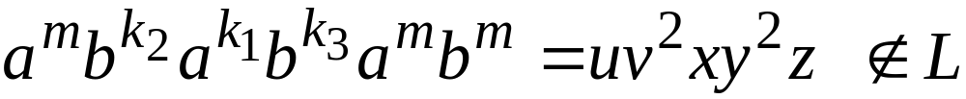
Case 3:
overlaps the first
is in the first
However, from Pumping Lemma:
Contradiction!!!

Slide 21
Case 4:
in the first
Overlaps the first
Analysis is similar to case 3

Slide 22
Other cases:
is within
or
or
Analysis is similar to case 1:

Slide 23
More cases:
overlaps
or
Analysis is similar to cases 2,3,4:

Slide 24
There are no other cases to consider
Since , it is impossible
to overlap:
nor
nor

Slide 25
In all cases we obtained a contradiction
Therefore:
The original assumption that
is context-free must be wrong
Conclusion:
is not context-free

Slide 26
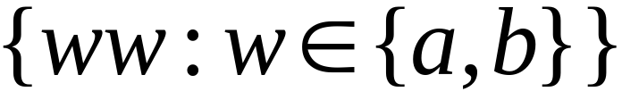
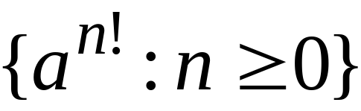
Non-context free languages
Context-free languages

Slide 27
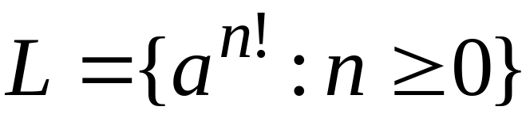
Theorem:
The language
is not context free
Proof:
Use the Pumping Lemma
for context-free languages

Slide 28
Assume for contradiction that
is context-free
Since is context-free and infinite
we can apply the pumping lemma

Slide 29
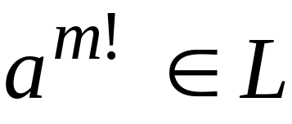
Pumping Lemma gives a magic number
such that:
Pick any string of with length at least
we pick:

Slide 30
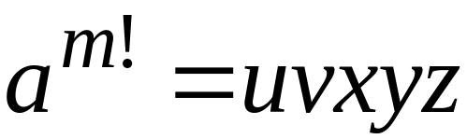
We can write:
with lengths and
Pumping Lemma says:
for all

Slide 31
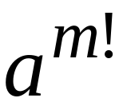
We examine all the possible locations
of string in
There is only one case to consider

Slide 32


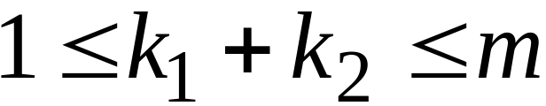

Slide 33
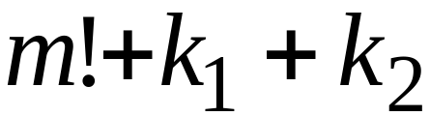


Slide 34

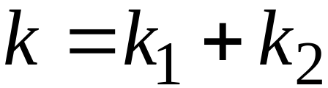


Slide 35
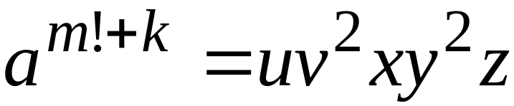

Slide 36

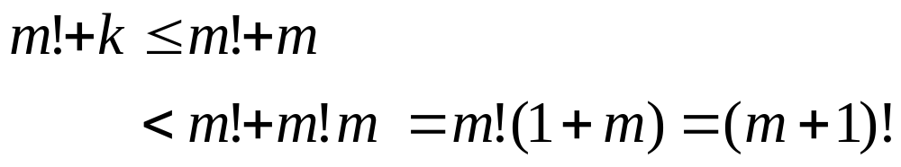
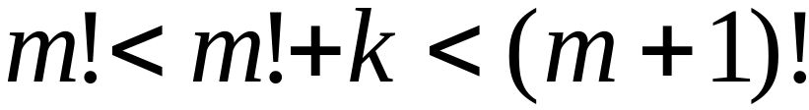
Since , for we have:

Slide 37
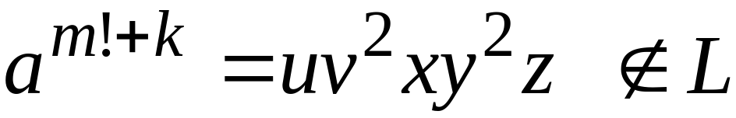

Slide 38
However, from Pumping Lemma:
Contradiction!!!

Slide 39
We obtained a contradiction
Therefore:
The original assumption that
is context-free must be wrong
Conclusion:
is not context-free

Slide 40
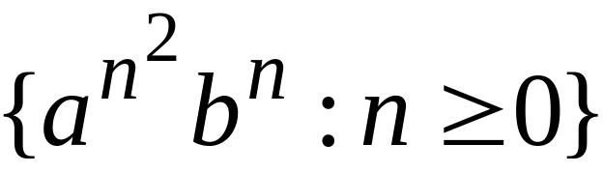
Non-context free languages
Context-free languages

Slide 41
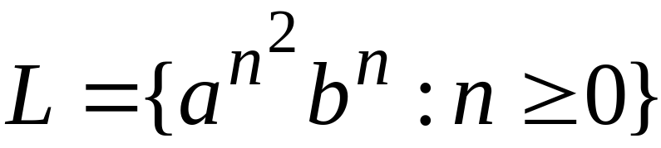
Theorem:
The language
is not context free
Proof:
Use the Pumping Lemma
for context-free languages

Slide 42
Assume for contradiction that
is context-free
Since is context-free and infinite
we can apply the pumping lemma

Slide 43

Pumping Lemma gives a magic number
such that:
Pick any string of with length at least
we pick:

Slide 44

We can write:
with lengths and
Pumping Lemma says:
for all

Slide 45

We examine all the possible locations
of string in

Slide 46


Most complicated case:
is in
is in

Slide 48


Most complicated sub-case:
and

Slide 49





Most complicated sub-case:
and

Slide 50

Most complicated sub-case:
and

Slide 51


and

Slide 52


Slide 53

However, from Pumping Lemma:
Contradiction!!!

Slide 54
When we examine the rest of the cases
we also obtain a contradiction

Slide 55
In all cases we obtained a contradiction
Therefore:
The original assumption that
is context-free must be wrong
Conclusion:
is not context-free

